Slide 1
How to choose the subscription number and the service number?
Type
Feature
Applicable people
Authority
Subscribe
number
Information dissemination;
Media information ;
Brand publicity
A daily message ;Fold into the "subscribe number" list ;
Having part of the interface ;
Advertising media information Corporate brand publicity ;The self media of rich original content ;
(Suitable for enterprise
organization and individual )
Service number
（Not fit for a person ）
Enterprise number
Customer Manager ；Product service ；
Similar to light APP
Four messages per month ；Display in the friends list ；
Having all the interfaces ；
WeChat payment
Need advanced customization development ；Apply to managing customer relationships；
Providing powerful product functional services；
Have an e-commerce service system
Enterprise number
（Enterprise ，Government ，Government-affiliated institu
-tions ，Other organizations ）
Enterprise OA platform ；Through internal employee relations ； Having all the interfaces ；Upper and lower cooperative relations
Infinite push ；Fold into the "enterprise number" list Having part of the interface；WeChat payment ；There is a concern for restrictions, and users must be invited to pay attention
Mobile OA platform for enterprise
internal communication ；Firm
upstream and downstream supply
chain relationship

Slide 2

Public location
Product service
Media information
ID
Name
describe
Pre sale and after sale
Humor
Professional technology
location
Product reservation
Service consultation
Real time hot spot
Head
and so on......
and so on.....
portrait
Source of attention ，Content preference ，Interactive analysis，Proportion of men and women ，geographical distribution ，Educational level ，Engage in a career ........
Master your strengths and weaknesses and user groups ；Perfect your own public number

Slide 3
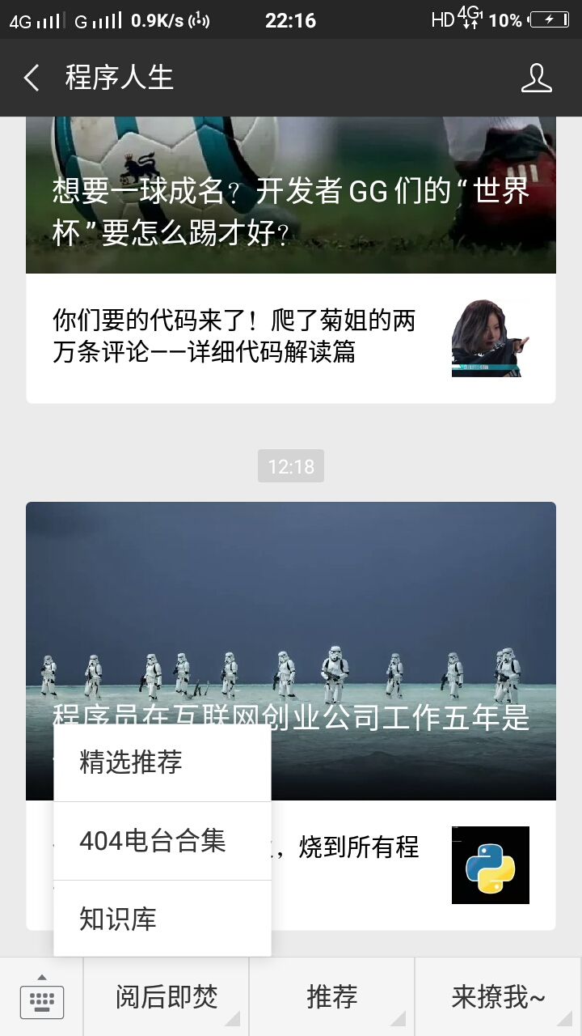
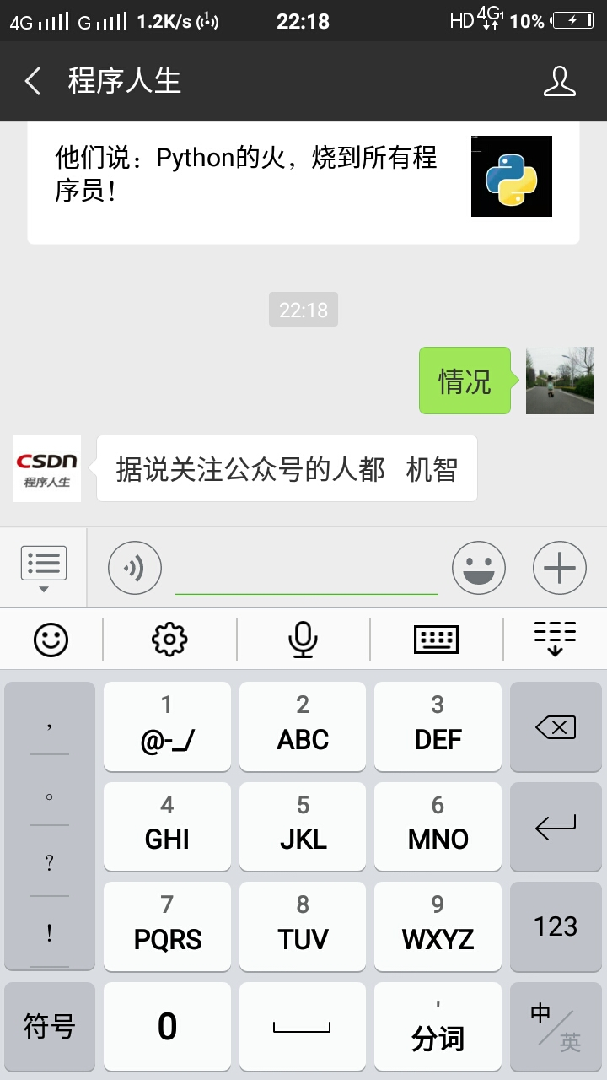
The foundation construction of the WeChat frame
Basic column
Keyword response preference
It needs to be set up for common services and articles ,Increase user interaction rate .
First attention to reply
First impression of the user ,Setting up public number introduction and directories and service functions .
Message reply
Random message reply ,Setting up the boot class message to help the user .
Custom menu
Set different types of functions and message push .
The function of custom menu should be detailed when providing service,a clear division of the three major categories .
Custom menu
Reply setting

Slide 4
The construction of the content framework
Title
Content
Typesetting
Typesetting frame
Try to optimize the appropriate adjustment.
In the morning
7:00-9:00
At noon
11:30-12:30
In the afternoon
14:00-16:00
At night
19:00-22:00
Focus on guidance and introduction
Of value 、Dried food
Digitization
Anticipation
Hot spot
Intimidation
How to body
Professional authority
and so on......
Content vision, scene, story
The user can feel the feeling
Contrary to user cognition
Emotionally rich
Taking advantage of the hot spots of current affairs
Suspense
The content has the conflict contrast ......
1.5 to 1.75 times the distance
The length of the paragraph is
adjusted to 2 times the distance.
The font is 16px - based
Highlights of key characters
Full text color is ununiform
Brief introduction of the introduction
The number of words should not
be too long and multi segment
introduction
text
The end of the text
Reading the guidance of the original text
In a word, take the user's feelings as the center

Slide 5
Promotion of channel construction
Online channel
Sub line channel
Media matrix | Promotion of activities | Personal social communication | Resource exchange | DSP platform | Local 020 and other offline resources
1.Self media web site 2.Web site submission 3.micro-blog 4.Post Bar 5.Forum 6.Personal website 7.Blog 8.library 9.Navigation website 10.And other ...... | Entertainment creative 1.Scratch lotto 2.Prize winning and answering 3.Game 4.Creative H5 5.Other ideas, etc. Event program class 1.Legal holiday 2.A hot spot 3.Self-made program ...... | WeChat system 1.WeChat group 2.Circle of friends 3.Other WeChat （Spread through the acquaintances and the circle of friends ） Other social software 1.Stranger 2.Near 3.QQ 4.Various groups ..... Spread through other social networks | 1.Self Media Alliance 2.Large number of resources exchange Be careful : Not only on the line ,some of the resources under the cable .Various exhibitions and salon resources swap .Not only in the WeChat system ,It can also be a swap of other forms of resources | 1.Third party extension platform 2.WeChat 3.Professional push Be careful : Pay promotion channel ,see whether the other person gives resources or not .The third party and the professional push team can find an introducer .and direct account consulting services | 1.Event planning 2.Cost budget 3.Incentive policy formulation 4.Ground push team construction 5.Personnel training FAQ 6.Stadiums and stadiums 7.Bill of materials preparation 8.Whole course monitoring 9.Maintenance and gift liquidation after the end of the activity 10.Analysis of active data 11.Activity summary file

Slide 6
Data evaluation
1.The growing flow of fans of the WeChat public
The number of new concerns per day in seven days ,abolish the number of people concerned ,net increase in number of concerns ,Accumulative number of concerns.You can see the growth of the user this week ,combined with daily graphic push, you can see what brings good growth.
2.Attribute characteristics and source analysis of WeChat public number fans
What channels do fans pay attention to .Vermicelli attribute ,Such as the proportion of men and women, geographical distribution.And combined with the usual interaction of fans .Detailed portraits and remarks are given to hardcore users and loyal users.
3. Interactive analysis of WeChat
The number of key times of daily vermicelli interaction,And the number of clicks in the custom menu bar .Adjust the effect according to the effect ,as well as the interaction and maintenance of old fans, and maintain emotional communication.
4.Interactive analysis of graphic and text push
The operators can see the number of each message,the number of people who read the number of people .To understand the operation
5.Statistical analysis of activity
As well as the interaction and maintenance of old fans, and maintain emotional communication,cost of sharing and promotion .
6.A summary of this week's operation
What's the problem this week ?Whether the problem is solved ?If not solved, put forward your own solution.
The growing flow of fans of the WeChat public

